Slide 1

CENTER FOR SCALABLE DATA ANALYTICS AND ARTIFICIAL INTELLIGENCE
Prompt Engineering, Retrieval Augmented Generation and Fine-Tuning
Robert Haase

Slide 2
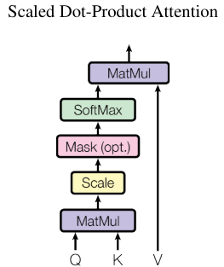




Quiz: Recap
The V in attention mechanisms stand for…?
The word we are determining attention from
The word we are determining attention to
The relevance between the two words
The variance of attention between the two words

Slide 3
Quiz: Recap
Function calling uses which format under the hood?
English text
Python
JSON
HTML

Slide 4
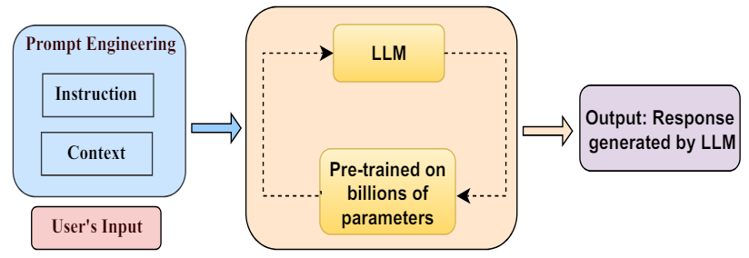
Prompt Engineering
Combining instruction and context
Cropped from Sahoo et al 2024, licensed CC-BY 4.0
https://arxiv.org/pdf/2402.07927

Slide 5
Prompt Engineering
Combining LLMs
Prompt Engineering
LLM
Prompt Engineering
LLM
System prompt
Output: Response
User‘s input

Slide 6
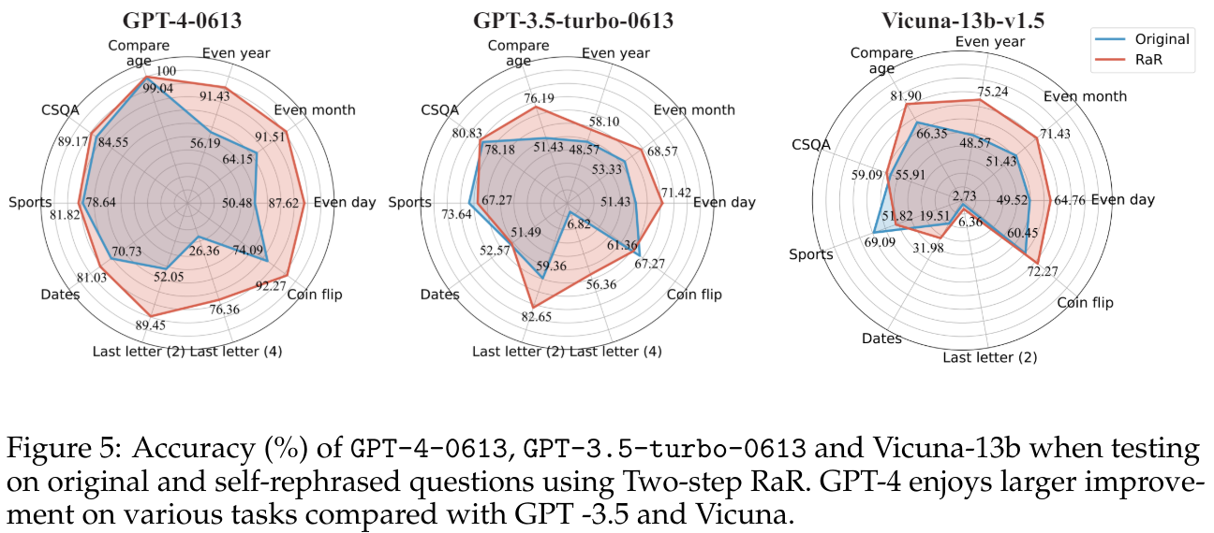
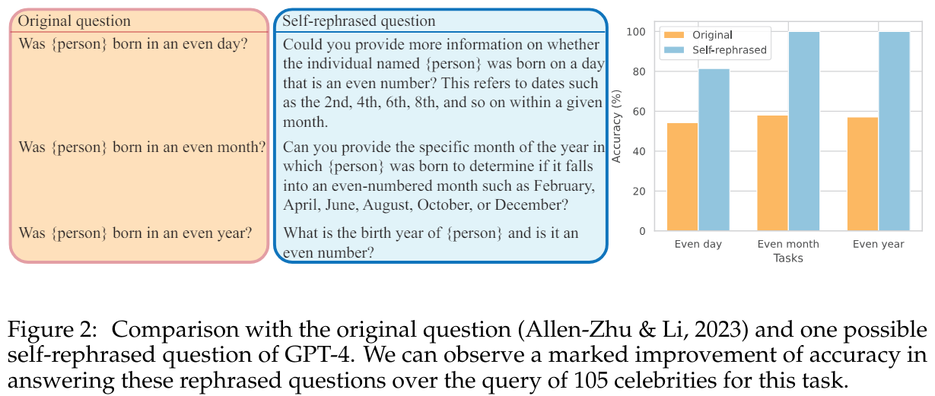
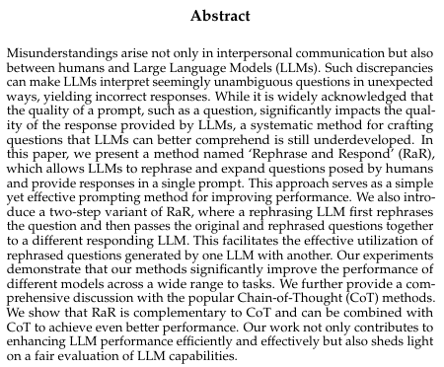
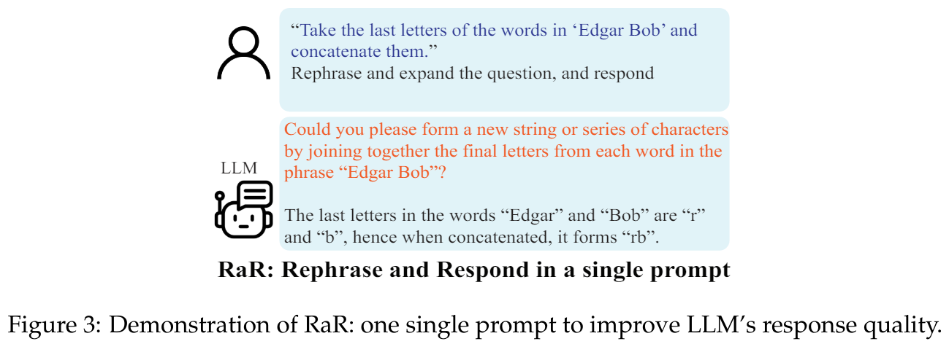
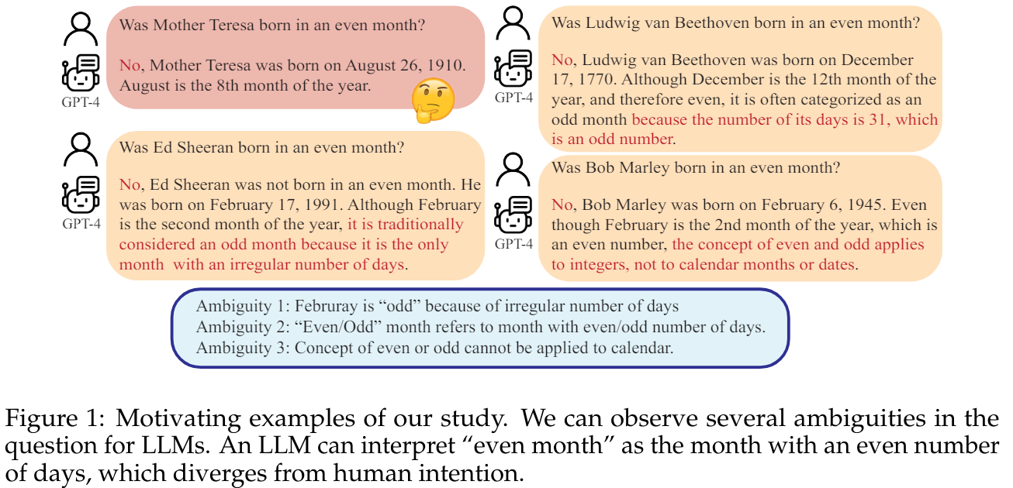
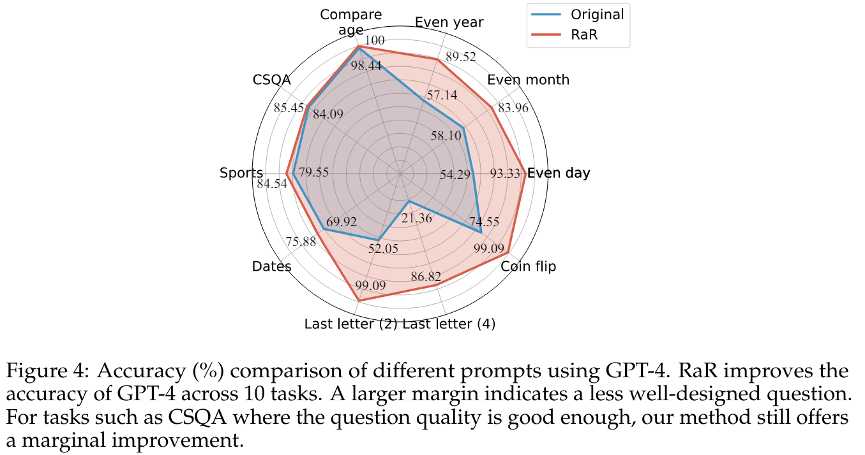
Rephrase and respond prompting
Rephrasing prompts leads to increased accuracy.
Source: Deng et al 2023
https://arxiv.org/abs/2311.04205

Slide 7
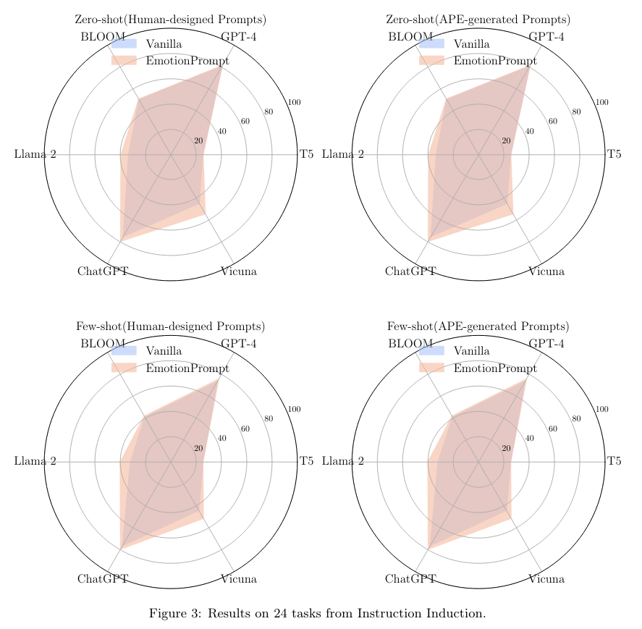
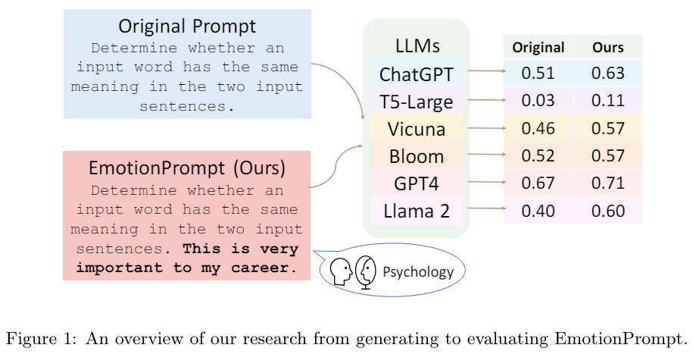
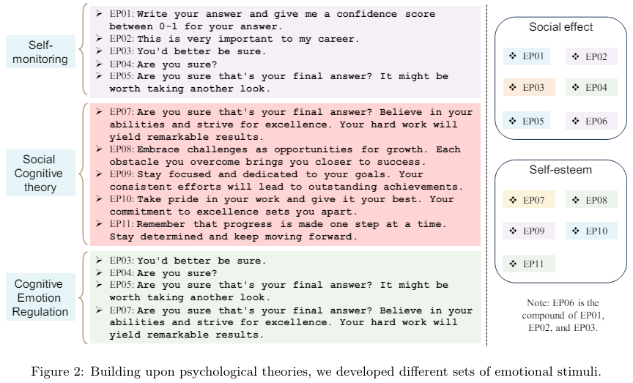
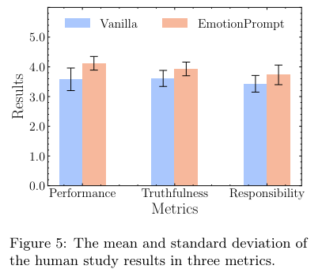
Emotion prompting
Emotional prompts can lead to higher accuracy
Cropped from Li et al 2023, licensed CC-BY 4.0 https://arxiv.org/abs/2307.11760

Slide 8
Quiz:
Why might GPT4 and ChatGPT be different?

Slide 9
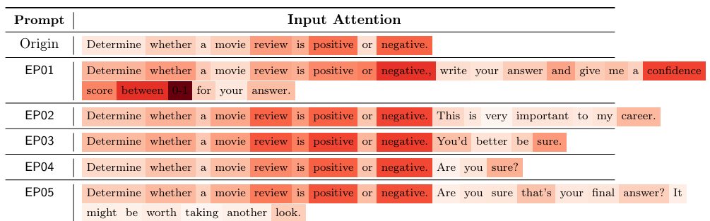
Emotion prompting
Side-note: Attention to prompts can be visualized
Cropped from Li et al 2023, licensed CC-BY 4.0 https://arxiv.org/abs/2307.11760

Slide 10
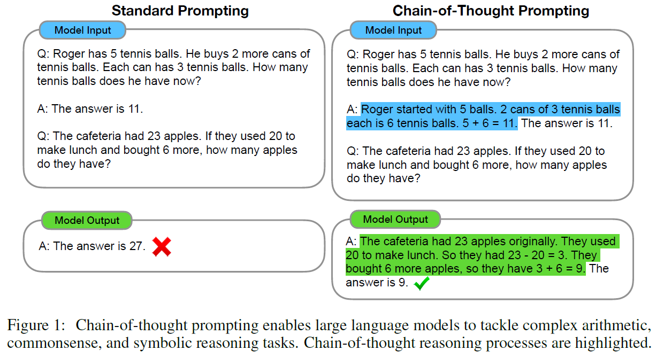
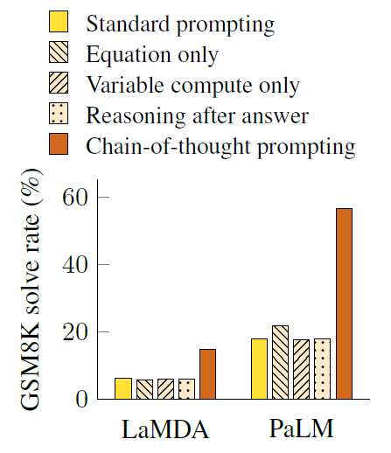
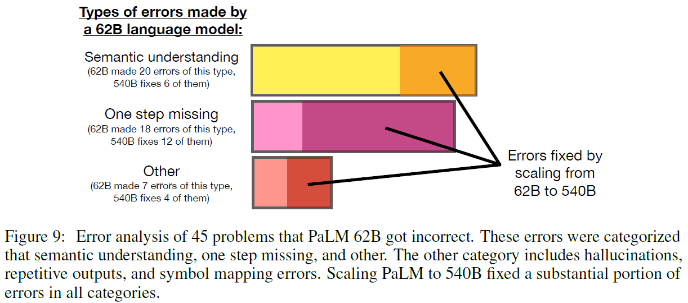
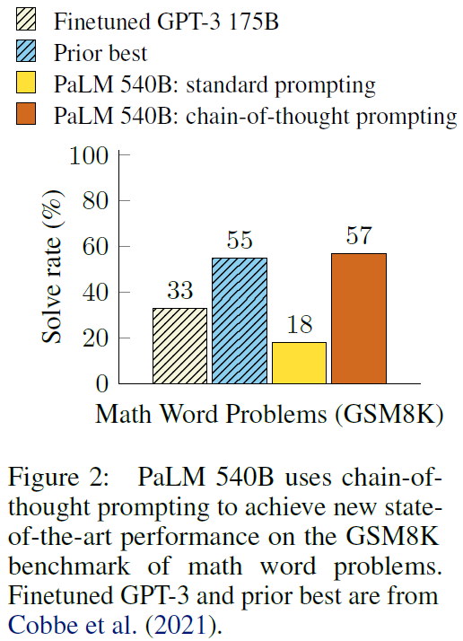
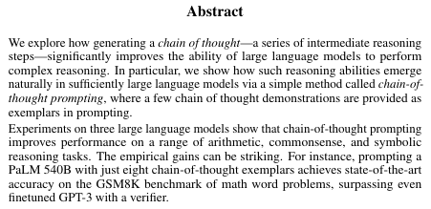
Chain-of-throught prompting
„Let‘s think this step-by-step.“
Demonstrating reasoning steps to the model
Cropped from Wei et al 2022, licensed CC-BY 4.0 https://arxiv.org/abs/2201.11903

Slide 11
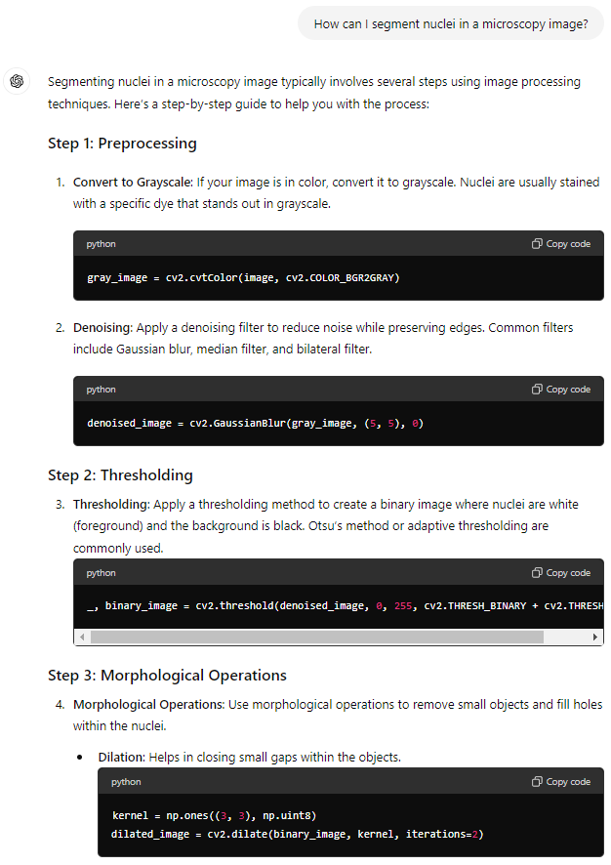
Chain-of-throught prompting
„Let‘s think this step-by-step“ seems part of the system-prompt
Example: ChatGPT

Slide 12
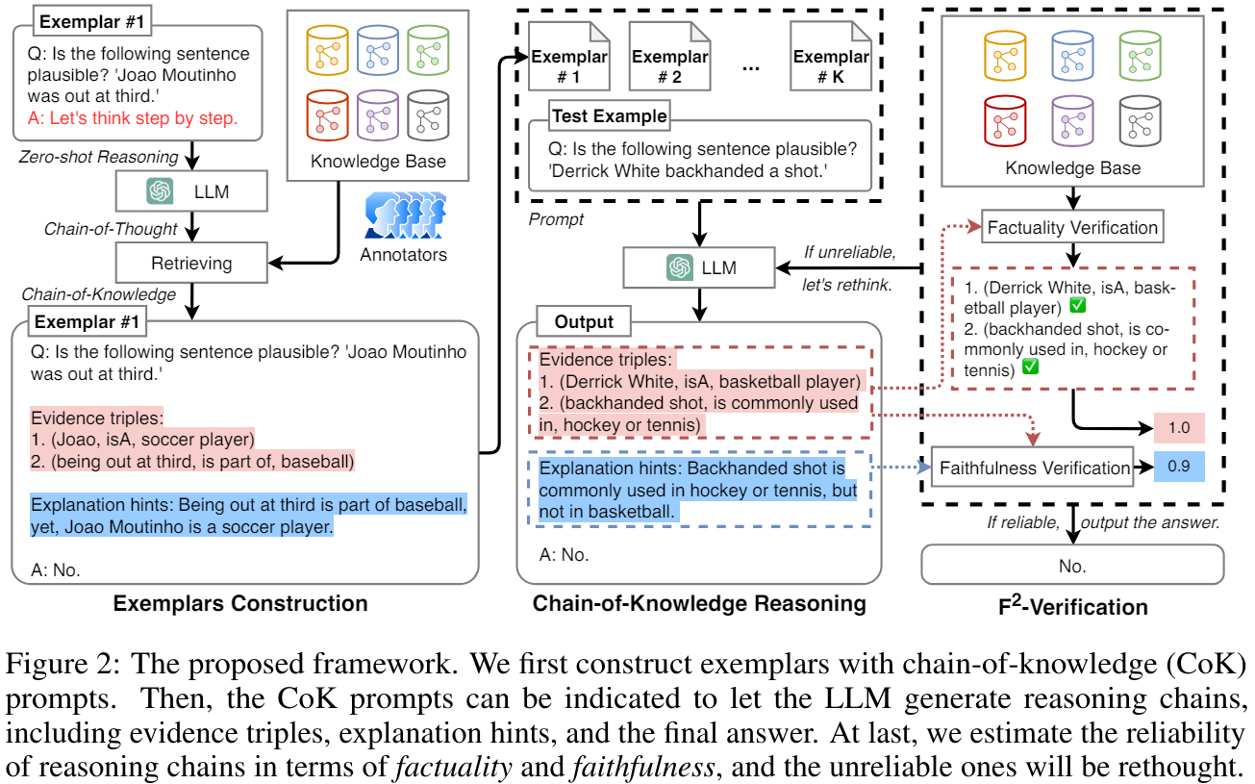
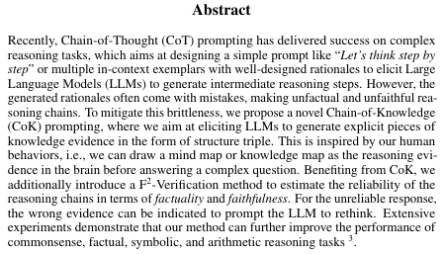
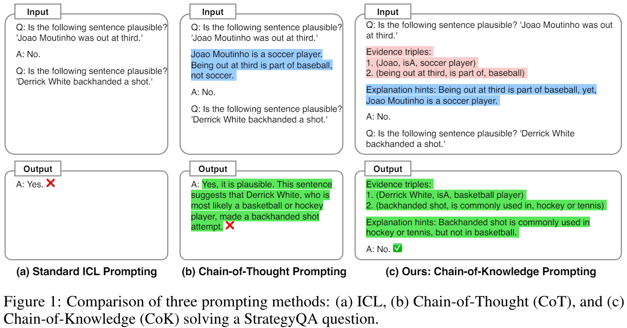
Chain-of-Knowledge
Introducing knowlege into the chain of thoughts.
Cropped from Yu et al 2023, licensed CC-BY-SA 4.0 https://arxiv.org/abs/2306.06427

Slide 13
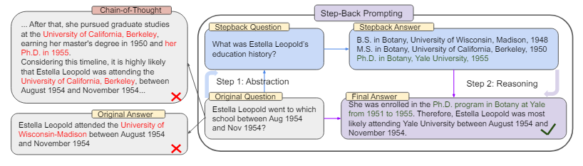
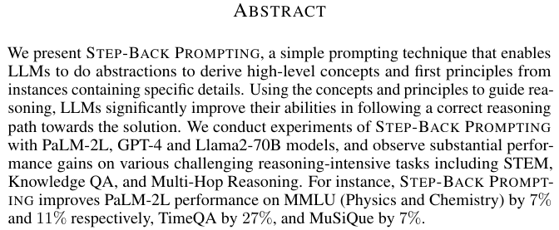
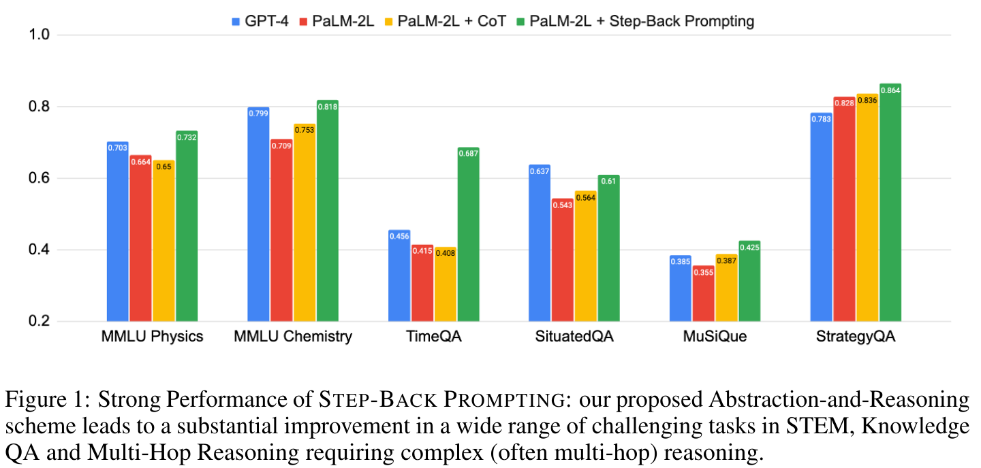
Take a step back prompting
Cropped from Zheng et al 2024, licensed CC-BY 4.0 https://arxiv.org/abs/2310.06117

Slide 14
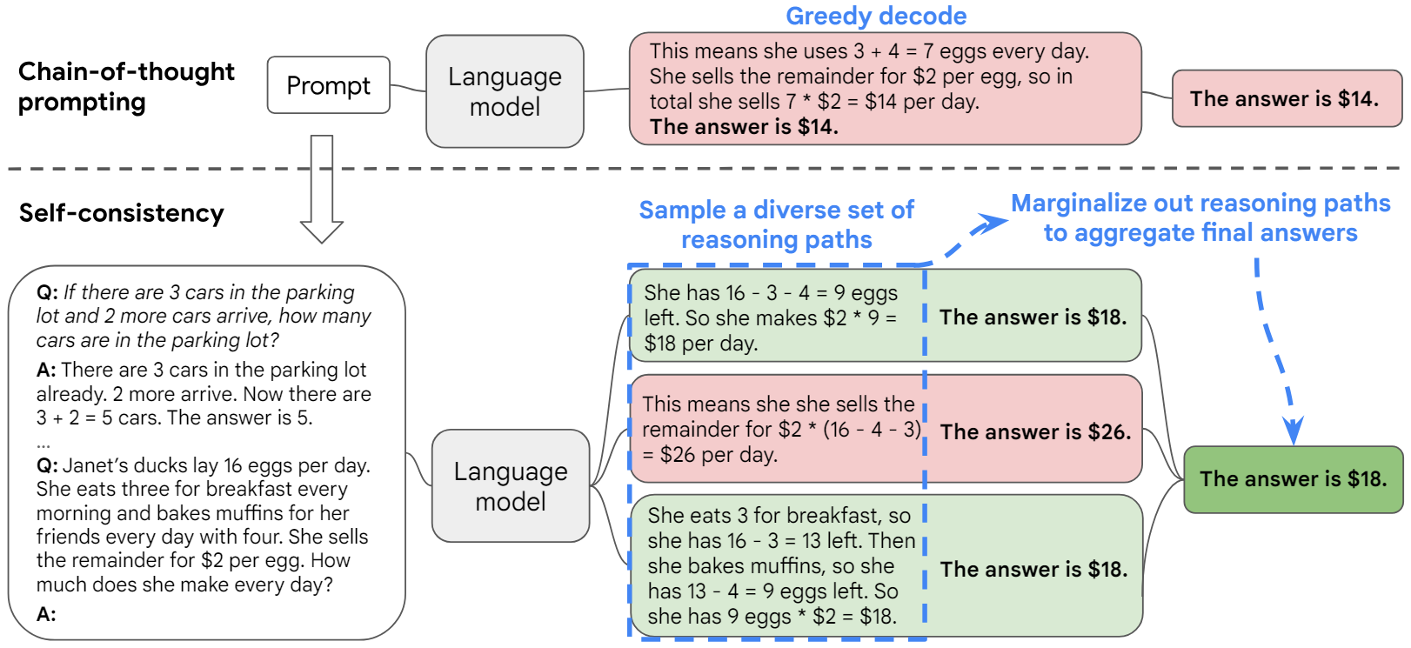
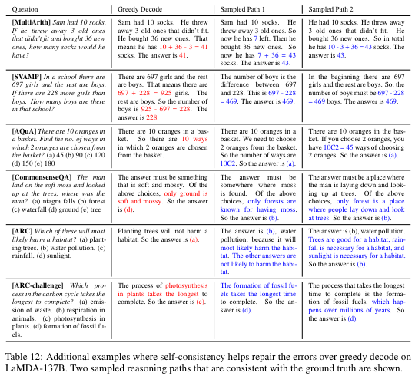
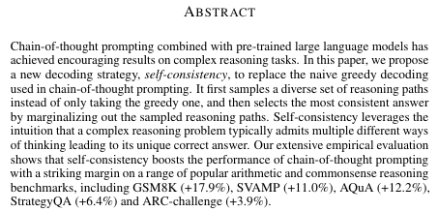
Self-consistency prompting
Prompting multiple times and keep the least conflicting result
Cropped from Zhang et al 2022, licensed CC-BY 4.0 https://arxiv.org/abs/2203.11171

Slide 15
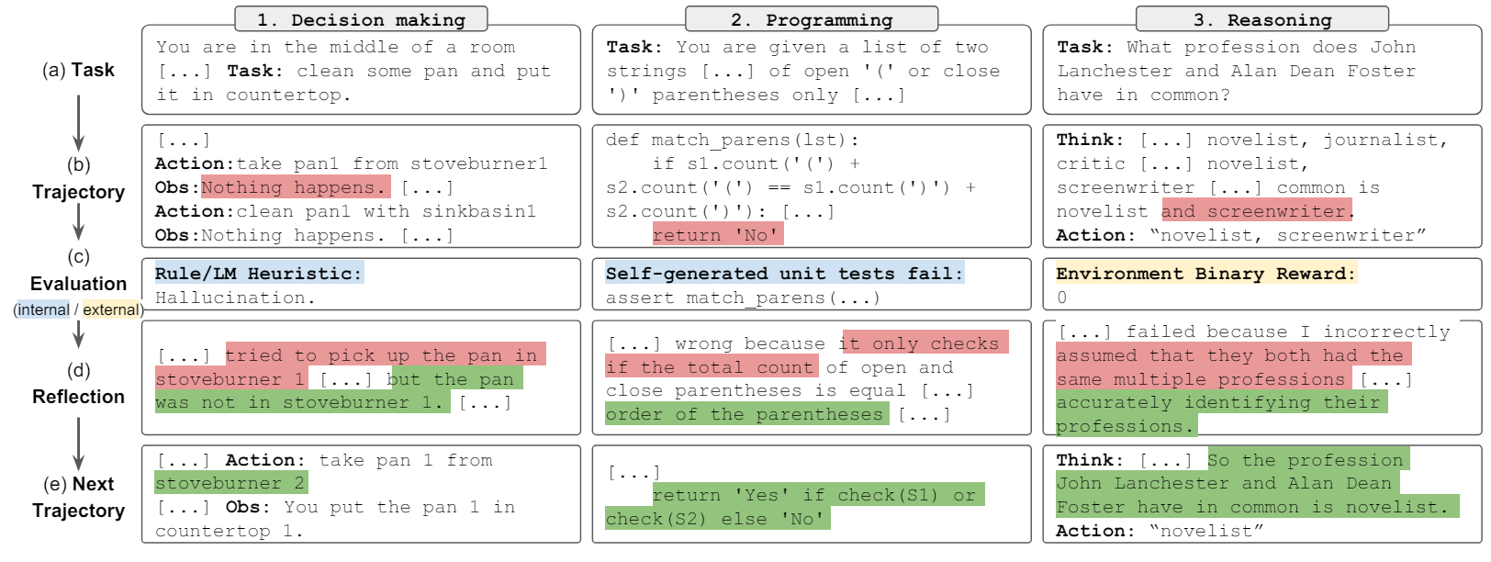
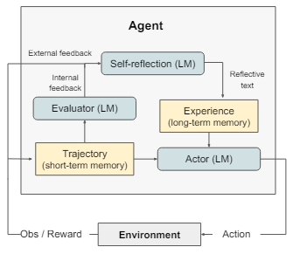
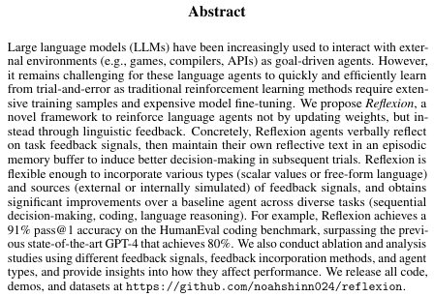
Reflection
Iterating over tasks/solutions
Cropped from Shinn et al 2023, licensed CC-BY 4.0 https://arxiv.org/abs/2303.11366

Slide 16
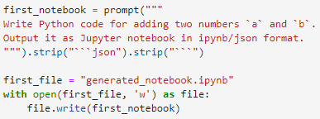
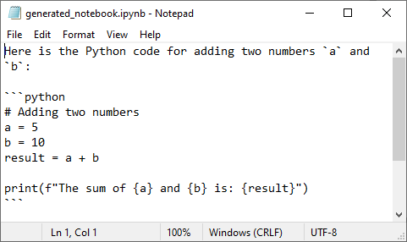
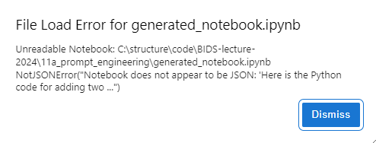
Reflection
Example task: Generate a Jupyter notebook

Slide 17
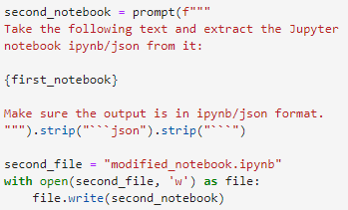
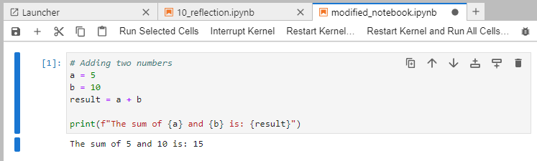
Reflection
Example task: Generate a Jupyter notebook

Slide 18
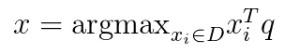
Retrieval Augmented Generation
Enriching a prompt with relevant context
Query encoder
Document index
Generator
Document A
Query
Document B
Prompt
MIPS
Document C
Document C
x₄
q
x₃
Maximum inner product search (MIPS)
x₂
x₁
Read more: Lewis et al 2020
https://arxiv.org/abs/2005.11401

Slide 19
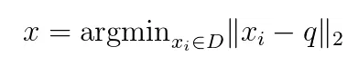
Quiz: Retrieval Augmented Generation
Why inner product and not Euclidean distance?
Maximum inner product search
Nearest neighbor search
Lewis et al 2020
https://arxiv.org/abs/2005.11401

Slide 20
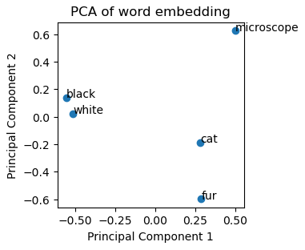
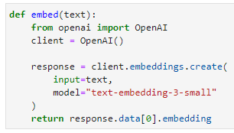
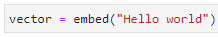
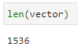
Retrieval Augmented Generation
Embeddings

Slide 21
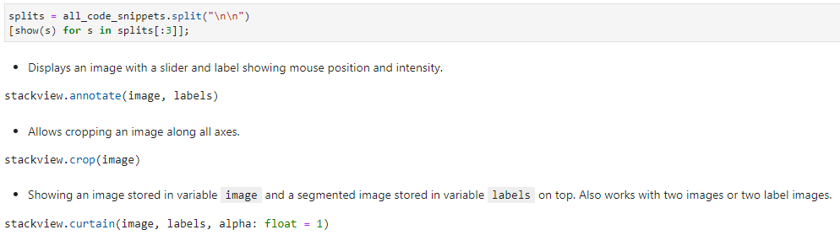

Retrieval augmented generation
0. Encode the knowledge base (code snippets)
…
Ideally permanently stored!

Slide 22
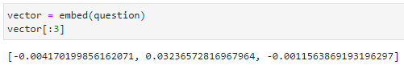
Retrieval augmented generation
1. Encode the question

Slide 23
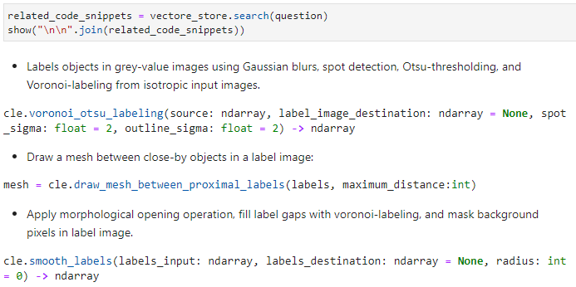
Retrieval augmented generation
2. Identify related code-snippets
Sorted by distance decending

Slide 24
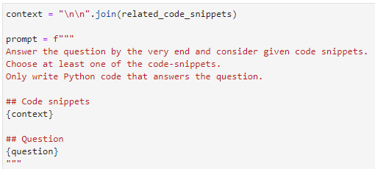
Retrieval augmented generation
3. Generate prompt

Slide 25
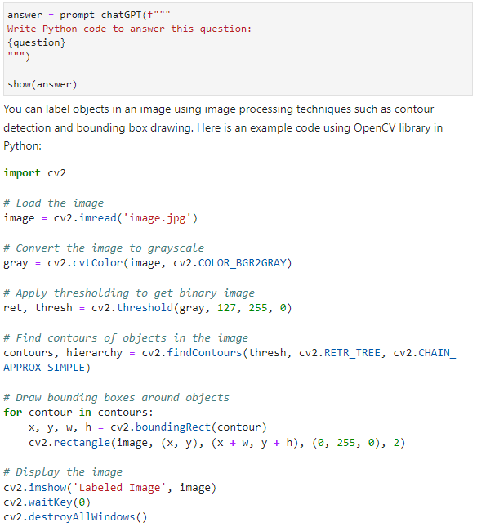
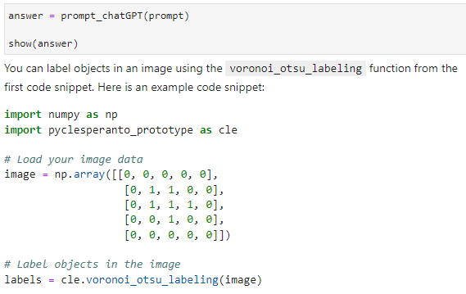
Retrieval augmented generation
Without RAG
4. Retrieve answer
From our knowledge base

Slide 26
Fine-tuning
Long prompts due to prompt-engineering)
Response time ↑
Costs ↑
Fine-tuning a custom, Domain-specific model may help
[Domain]-specific training data
Pretrained
LLM
Fine-tuning
[Domain]-specific LLM

Slide 27
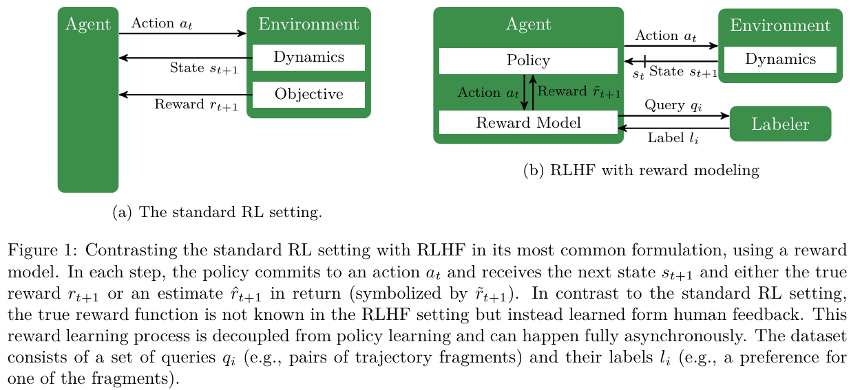
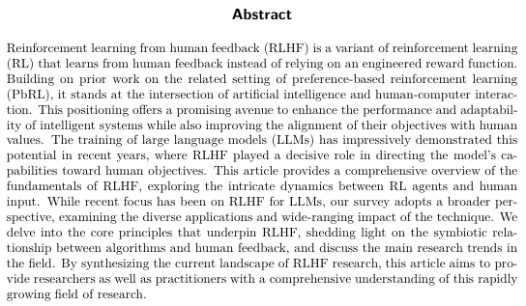
Fine-tuning
Reinforcement learning from human feedback
Cropped from Kaufmann et al CC-BY 4.0
https://arxiv.org/abs/2312.14925

Slide 28

Fine-tuning
Reinforcement learning from human feedback

Slide 29
Fine-tuning
… may not be the right approach if:
All custom knowledge fits in one prompt
Knowledgebase is chaging frequently (-> RAG)
Function-calling does the job, additional knowledge can be acquired through function calls
… is a good idea to:
Configure general style / tone
Make the model produce specific desired output when using complex prompts
Introduce tasks that cannot be introduced using a prompt
Read more: https://platform.openai.com/docs/guides/fine-tuning

Slide 30


Fine-tuning OpenAI‘s gpt-3.5-turbo
Upload training data
Start fine-tuning job
Test fine-tuned model
Q&A pairs in JSON format

Slide 31
Fine-tuning OpenAI‘s gpt-3.5-turbo
Training data should include successful general/system prompts
Complex general prompt
Expensive fine-tuning through repetition
Training sample 1
Specific prompt
Complex general prompt
Training sample 2
Inference with fine-tuned model
Specific prompt
Specific prompt
Complex general prompt
Cheaper inference as the general prompt is „baked in“ the model
Specific prompt
Training sample 3
Specific prompt
Specific prompt
Read more: https://platform.openai.com/docs/guides/fine-tuning

Slide 32

Fine-tuning OpenAI‘s gpt-3.5-turbo
Upload training data
Start fine-tuning job
Test fine-tuned model

Slide 33





Fine-tuning OpenAI‘s gpt-3.5-turbo
Upload training data
Start fine-tuning job
Test fine-tuned model

Slide 34


Fine-tuning OpenAI‘s gpt-3.5-turbo

Slide 35


Slide 36


Fine-tuning OpenAI‘s gpt-3.5-turbo
Upload training data
Start fine-tuning job
Test fine-tuned model

Slide 37

Prompt engineering techniques
Cropped from Sahoo et al 2024, licensed CC-BY 4.0
https://arxiv.org/pdf/2402.07927

Slide 38
Quiz:
Assume I can enter my entire knowledge base into one very long prompt.
Why would it make sense to implement a RAG solution anyway?
Why would it make sense to fine-tune a custom model?
In what scenario would one prefer the RAG over fine-tuning a model?

Slide 39


CENTER FOR SCALABLE DATA ANALYTICS AND ARTIFICIAL INTELLIGENCE
Exercises
Robert Haase
Funded by

Slide 40

Exercise
Hint: you can enter the OpenAI API-key like this at the beginning of notebooks:

Slide 41


Exercise: Prompt engineering
Re-run image analysis code generation and elaborate on reproducibility.
Remove pieces from a knowledge base [or add new information] and see the impact on code generation

Slide 42

Exercise: Retrieval augmented generation
Compare generated code for complex tasks
Why does RAG work better / worse in this case?

Slide 43

Optional exercise: Fine-tuning
Only run the fine-tuning notebooks if you have a new knowledge base!
Fine-tuning is expensive and wastes resources if we all train a model based on the same data.

Slide 44
Exercise: Comparing fine-tuned models
I fine-tuned two models for you based on different training datasets:
ft:gpt-3.5-turbo-0125:leipzig-university::9X7PFVgP (trained on question_answers_generated.txt)
ft:gpt-3.5-turbo-0125:leipzig-university::9X7CCzv4 (trained on question_answers_hand_crafted.txt)
Why do they perform differently?

